Slide 1
Important Information for 2021
Multiple learning modes
All content for the unit: ( https://github.com/uwacsp/cits5503)
Pre-recorded videos
Weekly reading material
Labs are assessed
Content of labs is examinable
You will be provided with AWS access – it is your responsibility to delete resources after their use and to protect keys and credentials
Assessment
Labs 20%
Mid-Semester Exam 30%
Final Exam 50%
Exam questions will be randomly drawn from a selection of the weekly questions provided during the semester

Slide 2
Important Information for 2021
Staff:
Unit Coordinator: Dr David Glance
email: david.glance@uwa.edu.au
Lecturer: Camilo Pestana (camilo.pestanacardeno@research.uwa.edu.au)
Tutors:
Daniel Chegwidden (21282744@student.uwa.edu.au)
Yunzhuo Chen (22075606@student.uwa.edu.au)

Slide 3
Cloud Computing Introduction
CITS5503 Camilo Pestana

Slide 4
Goals of Unit
In the context of Cloud Computing:
Understand cloud computing – how it lets us build global-scale services on shared hardware, why it’s hard, how to use it
Understand the technologies and tools that allow us to set up, manage and scale services on the cloud
Look at a couple of use cases for cloud computing that is “big data” and using clusters of machines to handle data analysis at scale

Slide 5
What Is this unit about?
“Cloud” computing
The substance behind the hype
How “elasticity” and shared infrastructure are useful
The hard problems that need to be tackled by software
The different layers and services
How to build your own dynamic, “cloud hosted” software as a service
And how to use “platform as a service” tools to analyze Big Data
“Scalable” computing
The issues in building global-scale services
Techniques for harnessing the power of thousands of machines to analyze data
The core ideas that span most tools, whether SQL, MapReduce, …
Strengths and limitations of those approaches
Fundamental design patterns, operation primitives, algorithms

Slide 6
CITS5503 in a Nutshell
How do we build effective data-centric applications, and serve them to the entire Internet?
You’ve learned procedural programming on a single machine – we’ll look at data-centric programming across thousands of machines
We’ll understand the issues in breaking up problems, global coordination, failures, and so on
We’ll study many of the algorithms used by cloud services
How do we take advantage of “the cloud” – the vision of computing as a utility (like the power grid)?
You’ll understand what lies underneath the cloud computing hype, and how to use the cloud
You’ll learn the technologies that allow services to be created and managed “on the cloud”

Slide 7
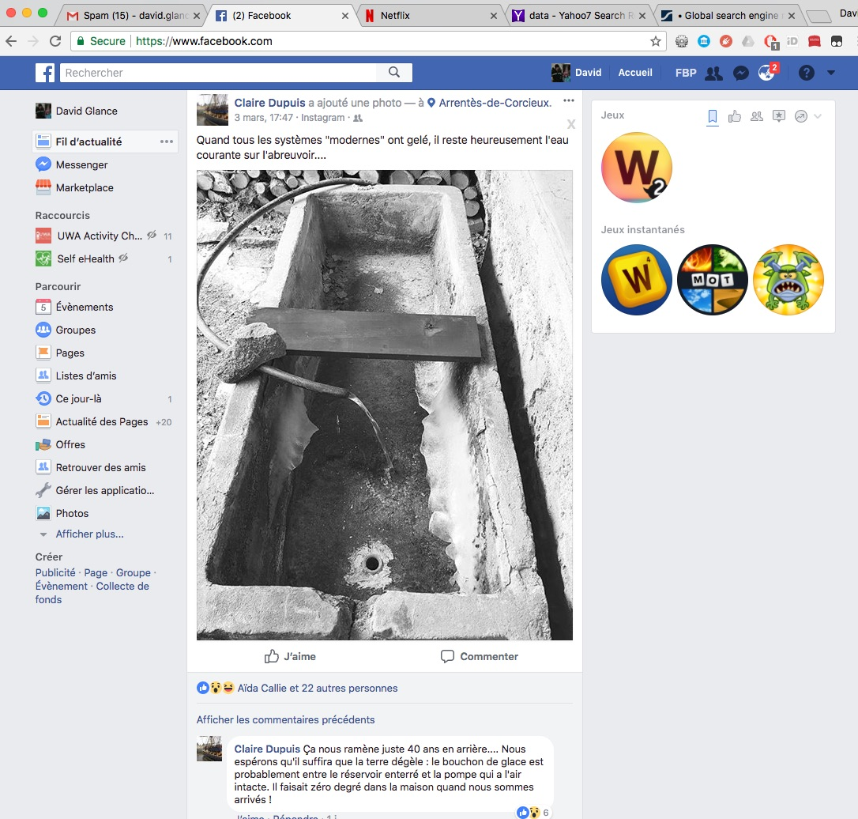
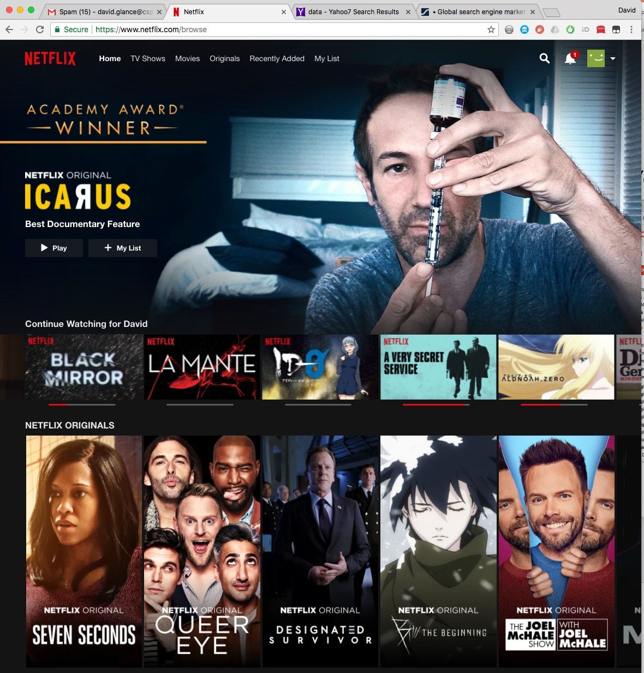
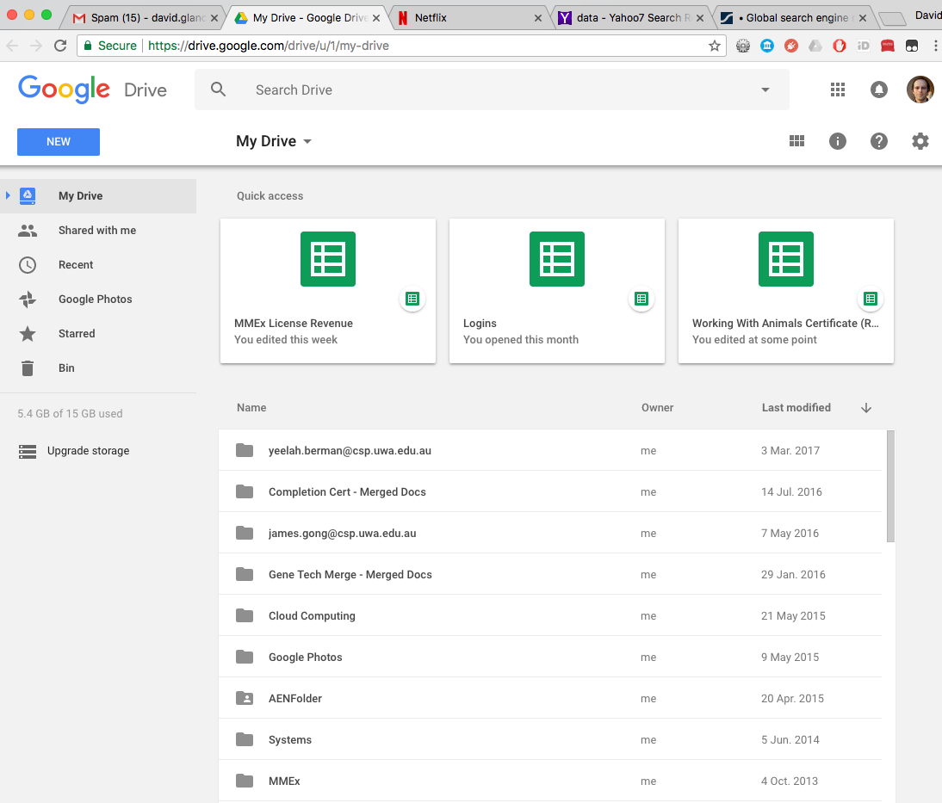
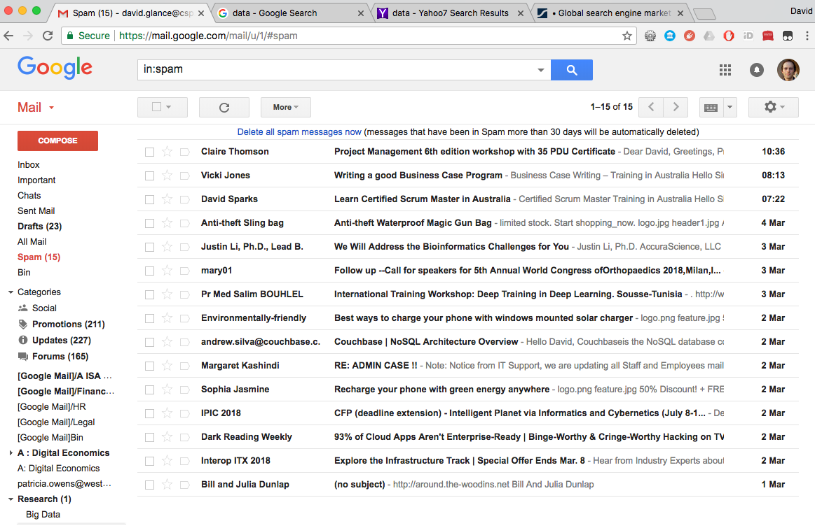
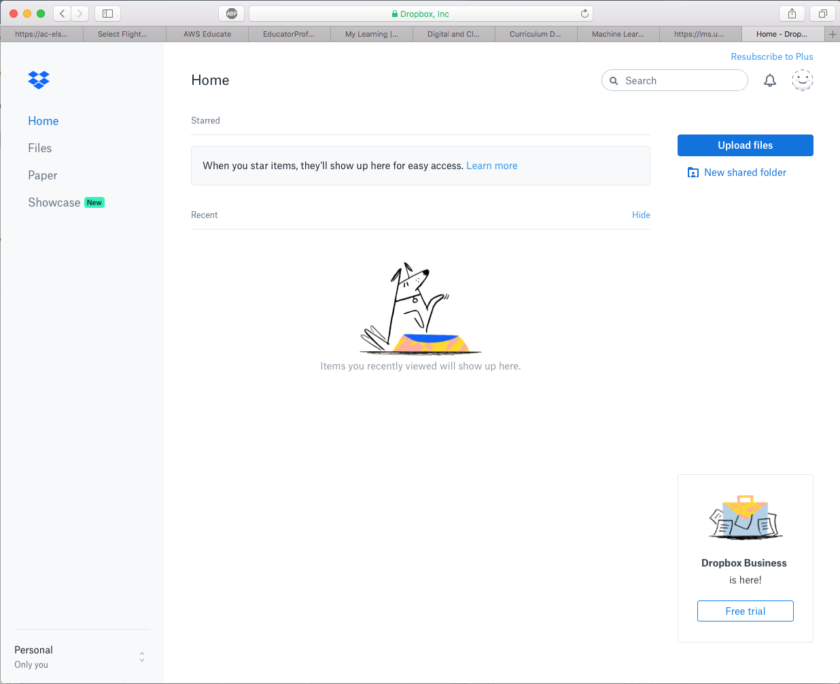
Do You Use “the Cloud”?

Slide 8
The Cloud on your phone
Google Assistant is an example of the Cloud, Big Data and AI, all in one
Hosted on Google’s platforms in their data centers
Bases its responses on personalized and population data, interpreted through natural language processing and machine learning (amongst other things).

Slide 9
The Cloud at Home
Personal assistants using speech to text, natural language processing, machine learning.
Smarts are in the cloud.
An example of Internet of Things

Slide 10
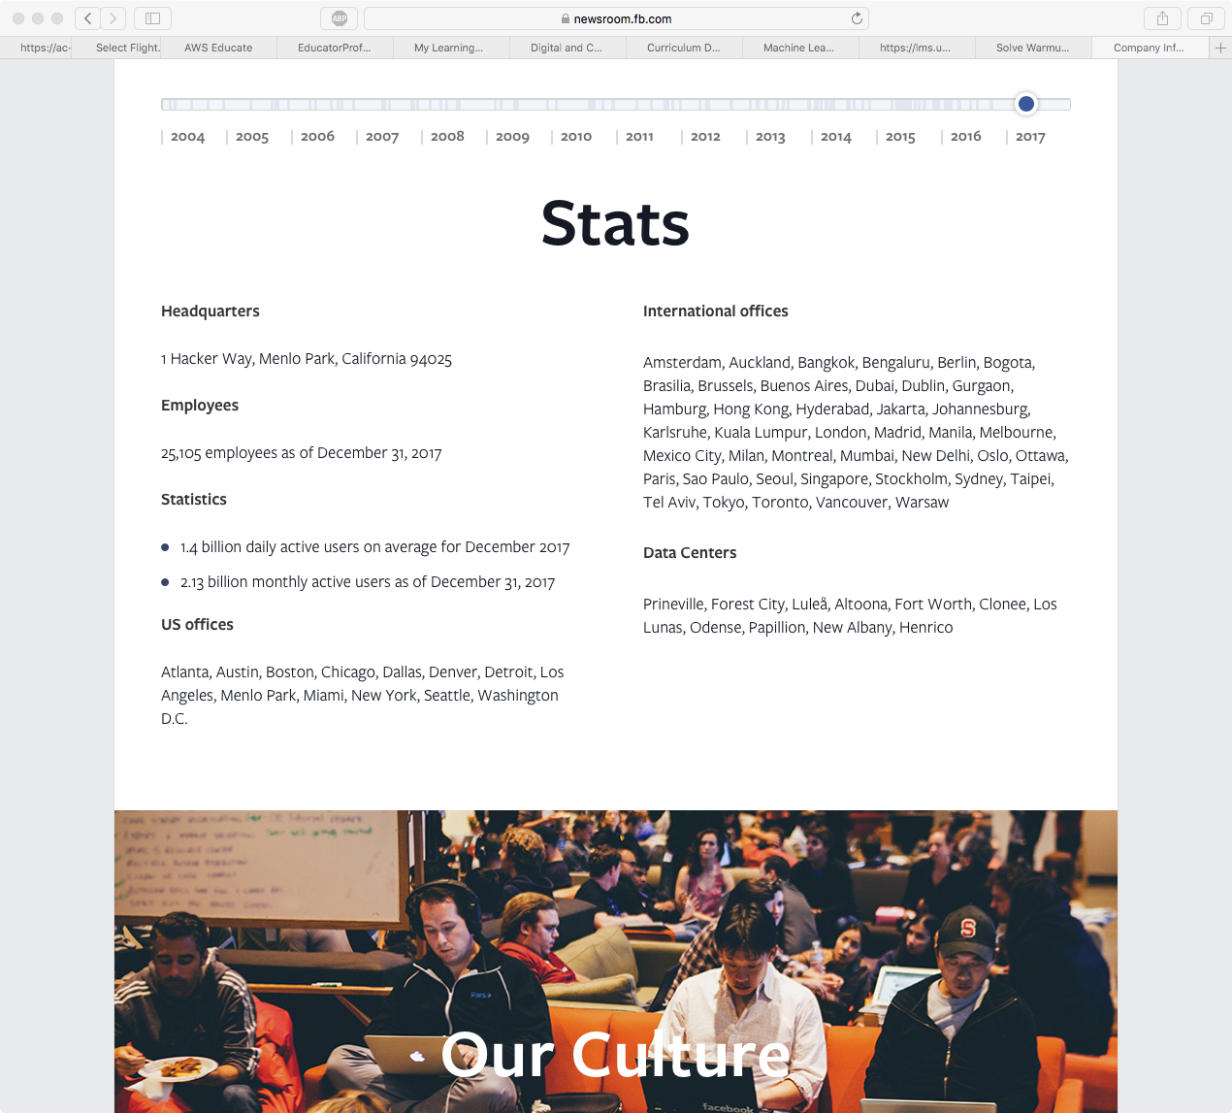
The Cloud Enables Scale: Facebook

Slide 11
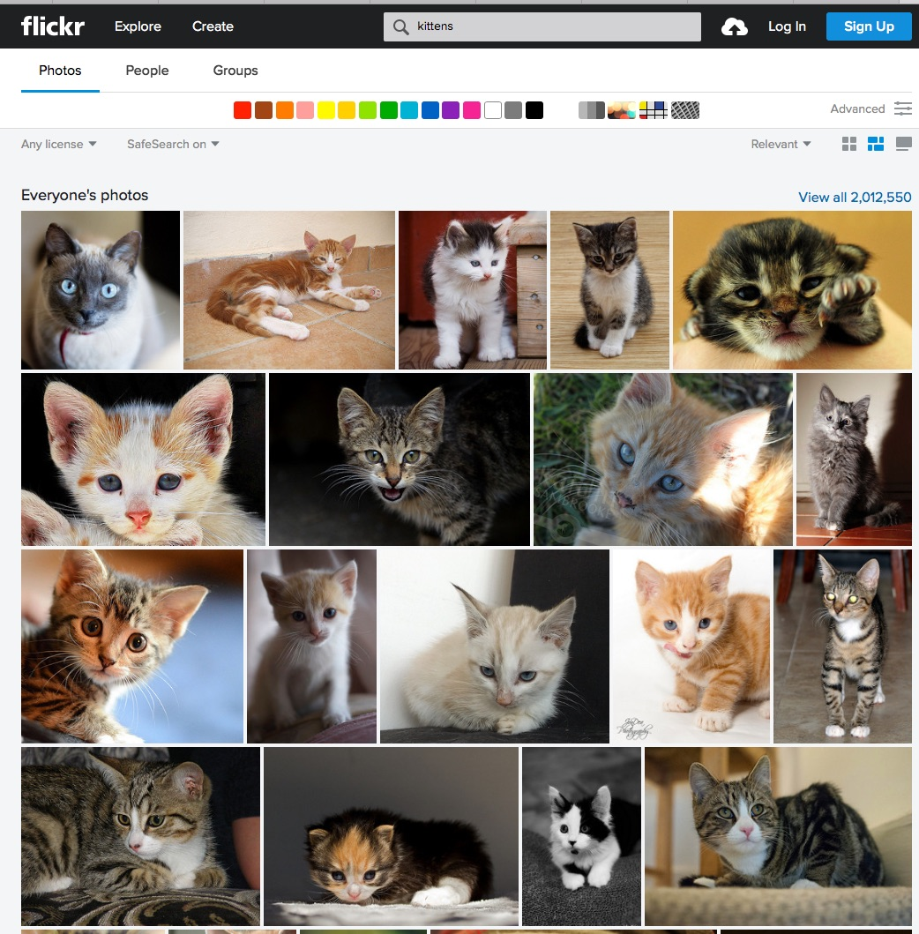
The Cloud Enables Scale: Flickr
90 m monthly users
75 m photographers
25 m photos uploaded on a busy day
1 m photos shared daily
10 billion images on flickr
Top camera: iPhone
https://expandedramblings.com/index.php/flickr-stats/

Slide 12
The Cloud Enables Data-centric Computing
Trend towards “data-centric” computing
(more about what this means later)
Intangible assets (intellectual property and data) now make up 80% of companies assets
Data, especially personal data has inherent value beyond its initial collection purpose
Brings in technical, social, legal and political challenges
Could be used for good (health research) or bad (advertising)
Data has become a currency: use it to pay for “free” services from Google, Facebook, Instagram, etc

Slide 13
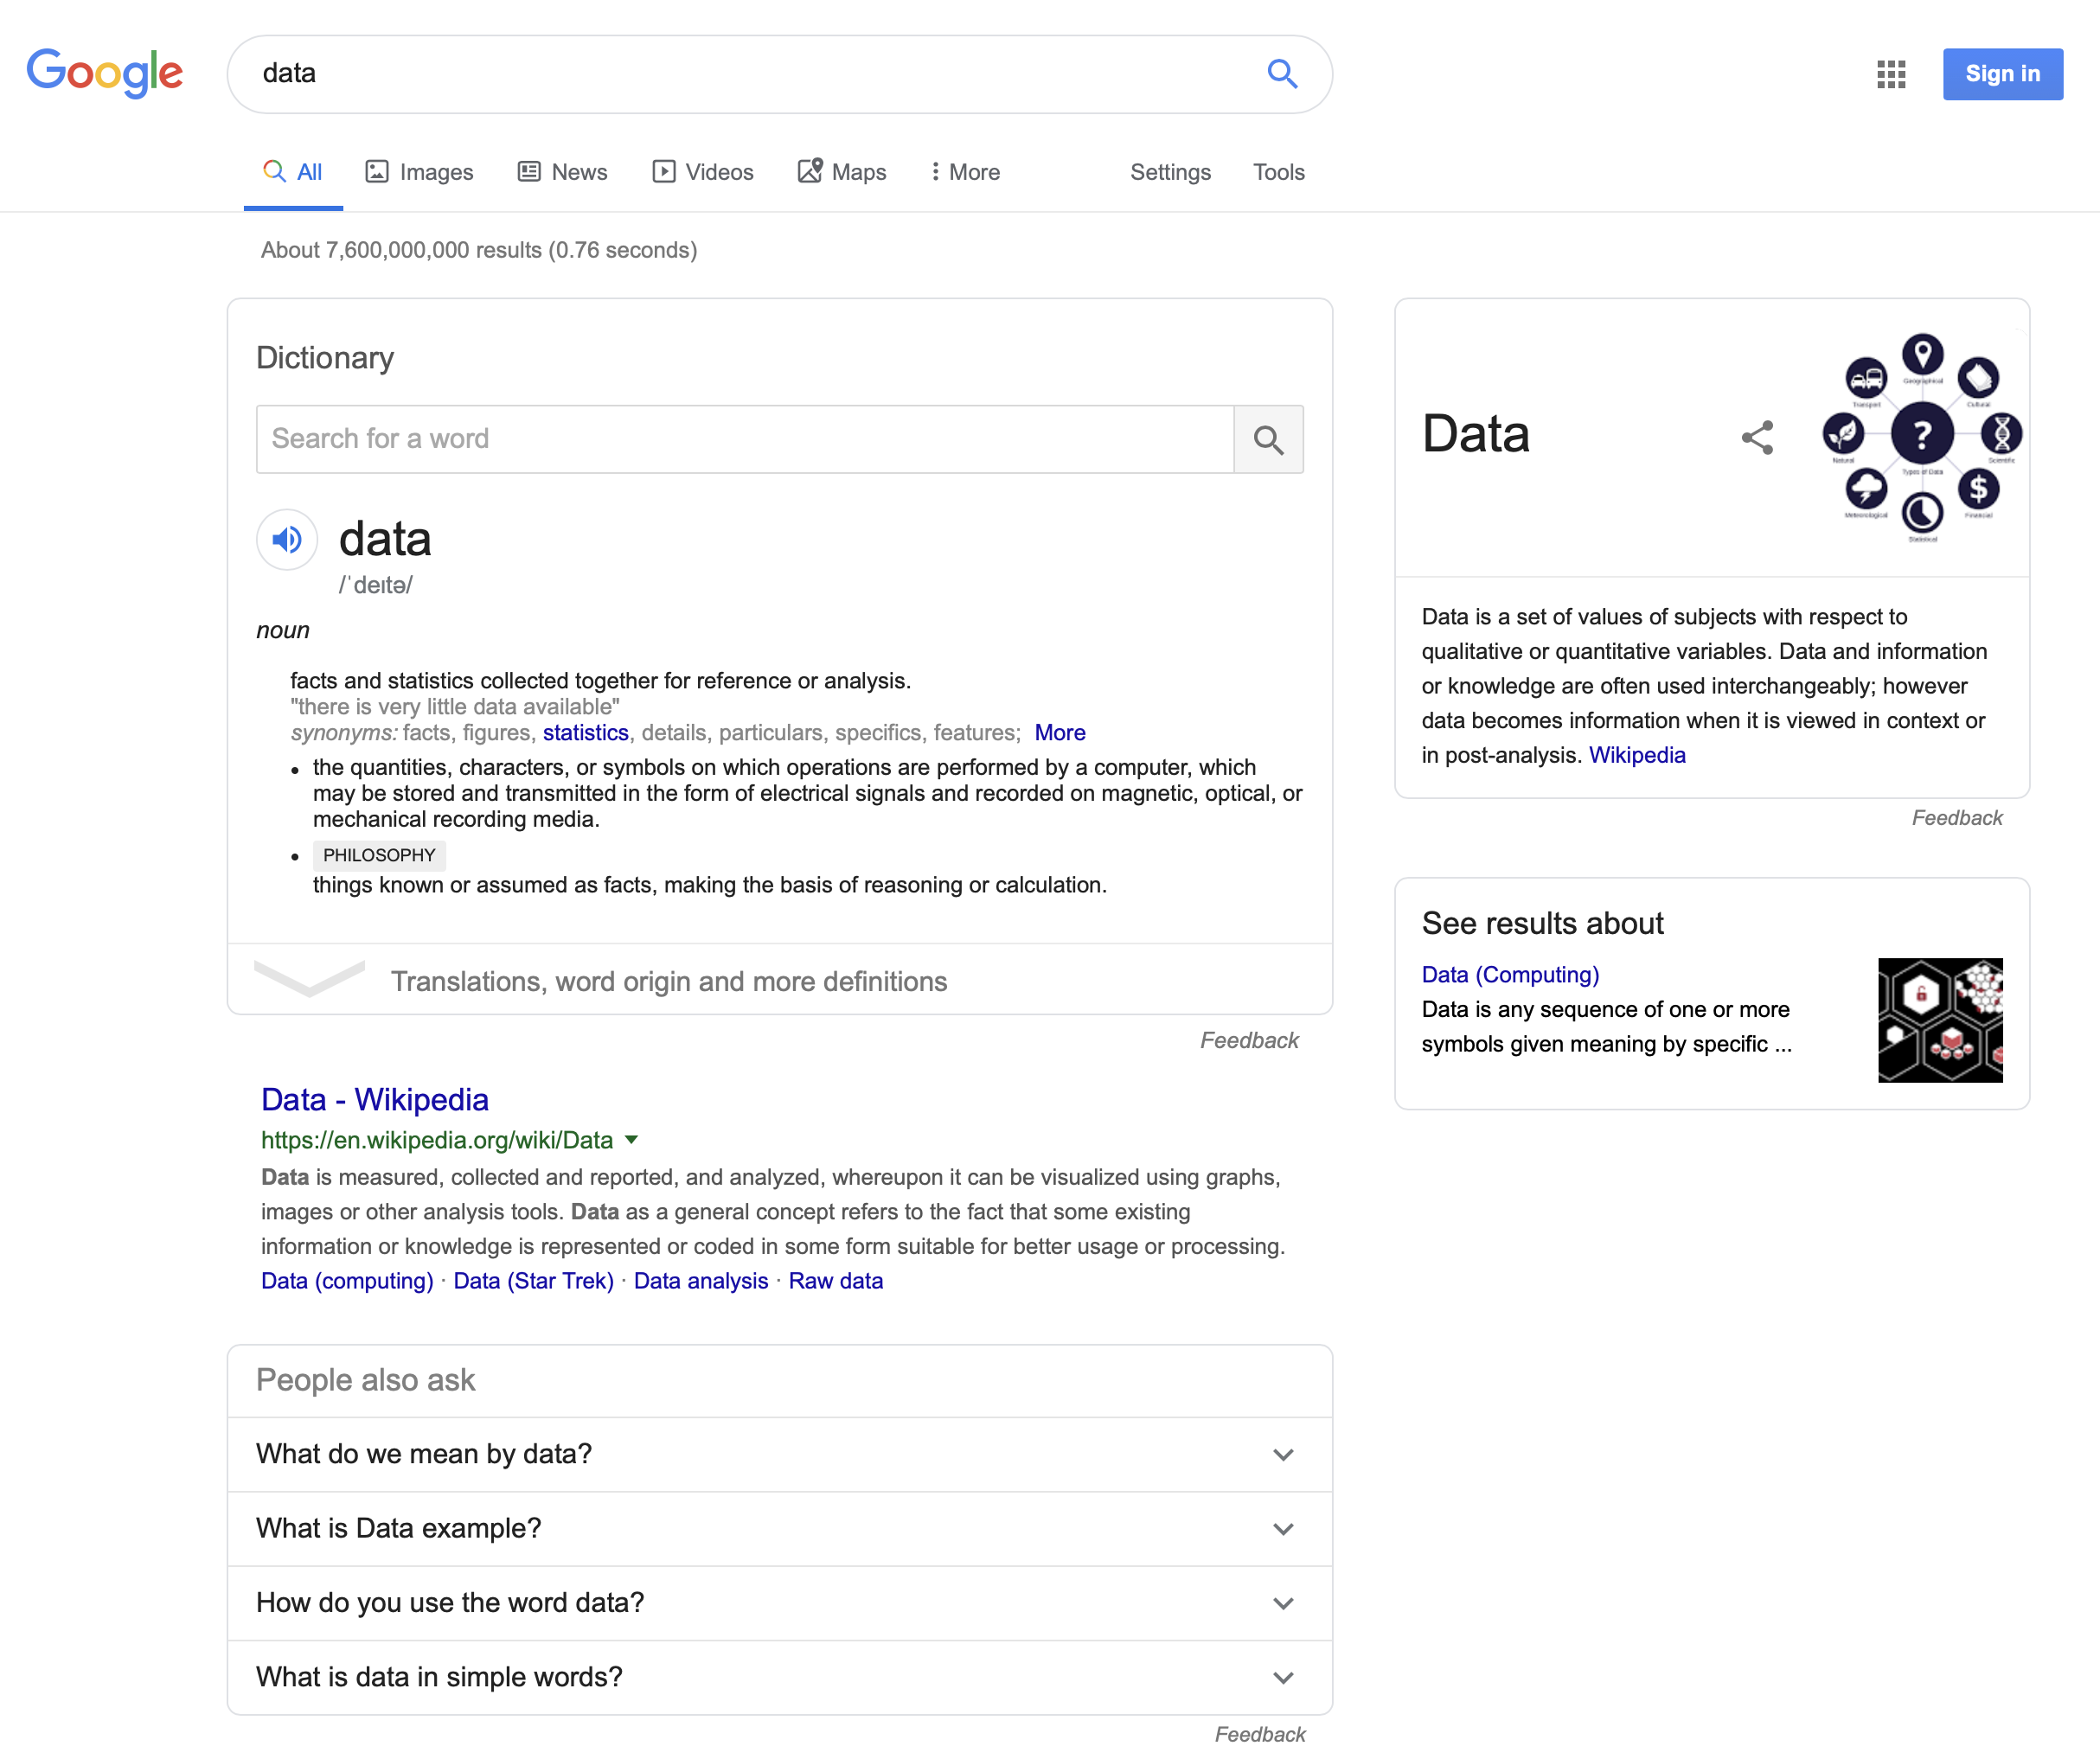
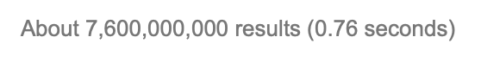
What kinds of data might we use?
We all know that Google gives good search answers because it has a lot of data…
… but what data, precisely, can it use, and how?
Let’s consider…

Slide 14
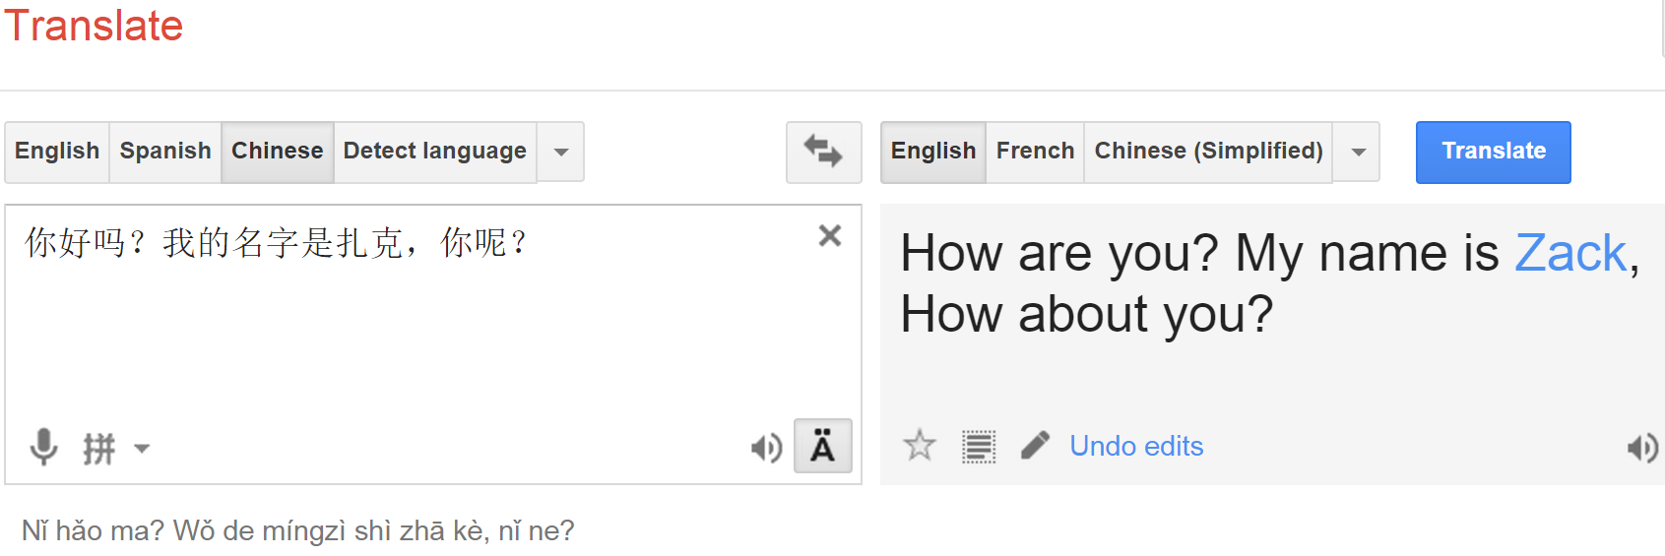
How does it work?
Google pre-crawls and analyzes millions of images, sentences, searches, etc. – builds models
Another example: Google & Bing Translate
Model how phrases in one language map to phrases in another language, by cross-comparing many, many translated docs

Slide 15
How does it work?
Collect data:
Spiders collect pages by following links on a page
Collects associated meta data and page content
Constructs a model using the Page Rank Algorithm that is one of around 200 criteria to connect words to links
Makes this searchable
Returns the search list in around 500 ms
The model also captures semantic information as a Knowledge Graph (semantic web)
Helps to provide further contextual information (search for airplane from Melbourne to Perth – returns current flight information)
Add personalization to drive more useful information for user and for advertisers

Slide 16
Data-centric computing is pervasive
Today, Google and Friends aren't the only "Big Data" players
Not just Google & friends - banks, financial firms, academia, the government, companies, military, startups, ...
All need to store and analyze huge data volumes
This is being enabled with a new generation of hardware “hosting” services – “the cloud” – and new, more scalable programming and analytical models

Slide 17
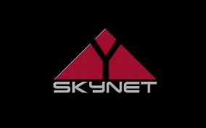
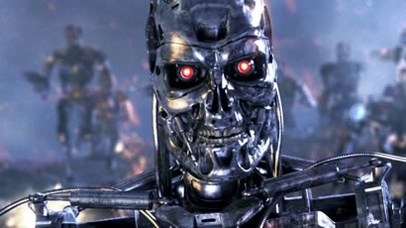
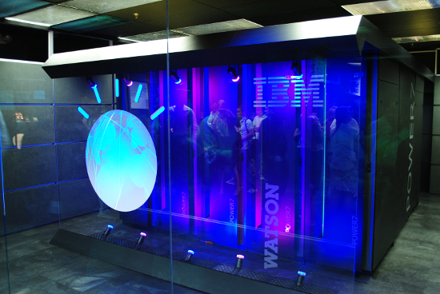
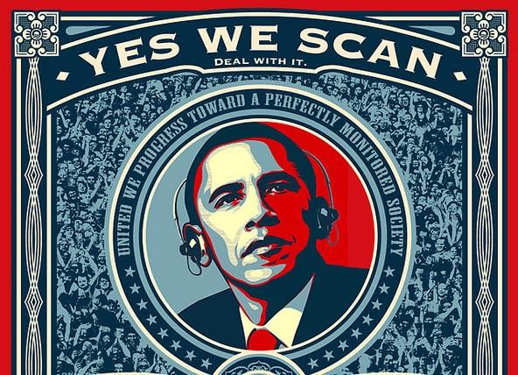
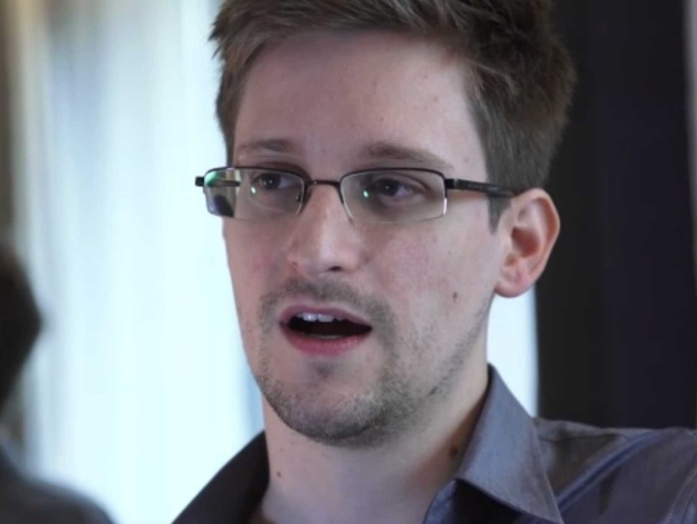
Should We Fear the Cloud and Big Data?

Slide 18
Remaining challenges
What does the technology let us do, and what remains hard?
How do we ensure privacy, security
As we have ideas for useful, fun, helpful services, how do we make them happen?

Slide 19
Goals of the Unit
Understand what's underneath the Cloud
How does it work? What are its strengths? Its shortcomings?
Technologies
Understand the underlying principles
How do you build something that is so scalable, robust, etc.?
Lots of clever algorithms needed - very different environment!
Be able to use the right approach when designing new protocols and web systems
How would you go about building the next Facebook?
Need to scale, be efficient, avoid failures, prevent intrusions, ...

Slide 20
Goals of the Unit
Gain practical experience with cloud technologies
Often, the best way to understand it is to use the technology
Understand the impact on society
Vulnerabilities, privacy concerns, data survivability, ...
Need to understand the current state of the technology!
Anticipate what's possible in the future

